Slide 1
Standard User – Contract Editor Features: Modify Language Text and Terms using the Emptoris Ribbon
August, 2013

Slide 2

Learning Objectives
Upon completion of this course you will be able to:
Edit Language Terms and Text
Understand how to use the Contract Editor (esp. Language tab) and the Emptoris Ribbon (MS Word Editor) to edit language and Terms of a contract
    Note that not all MS Word functionality is supported by the Language Editor. For a list of such functions, see the “Changed and Suppressed Microsoft Word Commands” section in the Configuration and Formatting Guide
Accept / Reject Changes
Add a Clause
Delete a Clause
Select an Alternate Clause

Slide 3
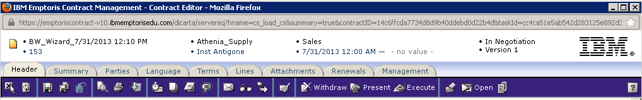
Contract Editor Toolbar and Tabs
The Contract Editor has several tabs and icons that you use to work on your contract. Tabs include:
Header tab: contains general information about your contract
Summary tab: displays a Management Summary; a single place to view key elements of the contract. This replaces cover sheets used for paper contracts and gives approvers a very clear summary of what the contract is about. It includes:
  Text area(s) to add additional information/summary about contract
  Terms
  Modified/replaced clauses – with or without the clause text
  Specific clauses
  Relationships
  Custom properties
  Activity – who reviewed this or who approved it
Parties: identifies the Internal Contact(s) and External Party/Parties for the contract
Language tab: contains the contract language
Terms tab: contains the variable information and values defined by the template
Lines: applied to a Purchase or Sales Agreement and contains product/price information (not used)
Attachment tab: contains documents associated with your contract
Management tab: helps you manage the contract lifecycle (covered in later modules)
Notes:
NOTE: Performance tab is used in a module that COP chose not to purchase. Disregard that tab.

Slide 4
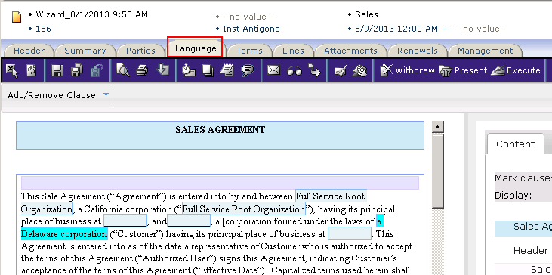
Language Tab
The Language tab is where you view and update the legal language and terms of the contract.
Prior to ECM V10, this window was a ‘read only’ preview of the contract language.
Starting in V10, many changes can be made directly on the Language Tab (through the HTML representation) without opening the Language Editor (MS Word).
    The exceptions are changes to language text and formatting (Word needed).
    Contract formatting such as margins and the use of multiple columns does not get reflected on the Language tab, only in Word.

Slide 5
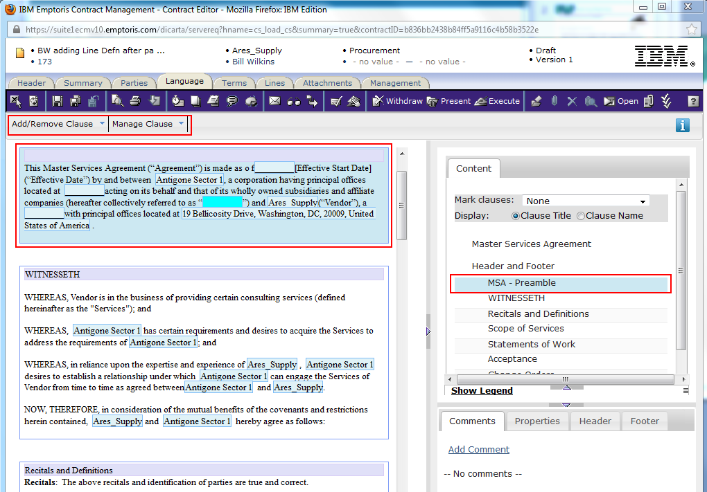
Language Tab as of V10

Slide 6
Language Tab Notes
As of V10, the Language Tab has a new toolbar area just below the existing dark blue tab (which is immediately below the Language tab itself)
Like the current toolbar, the new one provides context-sensitive options, depending on what is selected, but instead of inappropriate or unavailable options being grayed out, they are not visible at all
  e.g., On the previous slide, the “MSA – Preamble” clause has been selected (indicated by the blue shading). As a result, options related to that clause are displayed (Add/Remove Clause menu, and Manage Clause menu).
Other context-sensitive options are available by positioning at a location and right clicking
  e.g., click in the middle of a clause and right click to insert a Term
  e.g., click in a Term and right click to edit or delete the Term
Formatting changes are indicated by this star icon:

Slide 7
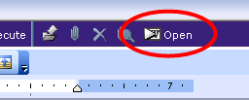
View Language
The Language Editor uses MS Word and includes all of your MS Word toolbars as part of the editor.
  It also includes the Emptoris toolbar (ribbon) with MS Word editing functions.
Common modifications include:
  Entering (or changing) Term values
  Editing (adding, deleting or changing) Language text
  Adding Clauses
  Deleting Clauses
  Selecting Alternate Clauses
  (As of V10, most of these can be done without the
  Language Editor, but they can still be done there)
To make changes to language text and formatting, navigate to the Language Tab and then click on the Open icon on the main, blue toolbar.

Slide 8
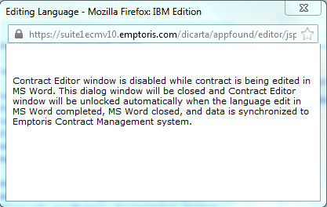
Contract Editor Disabled
When MS Word edit language is opened, the Contract Editor is disabled until language edits are complete.
This window is informational only, and should be closed automatically when you complete the editing in Word.

Slide 9
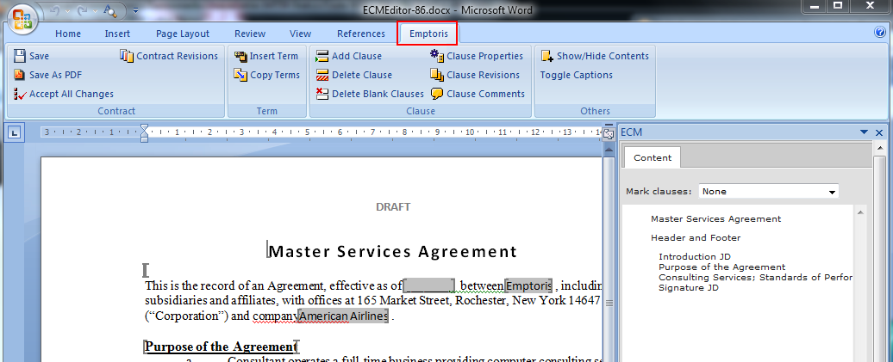
MS Word Edit Window
MS Word edit window is displayed [Word 2007 is shown]. In some cases you may be prompted to save the document first; in this case, save it, then open it. The document will open in Word, then, after a brief delay, the Emptoris ribbon should appear.
The Contract Author enters values and edits the language and the terms for the contract.

Slide 10
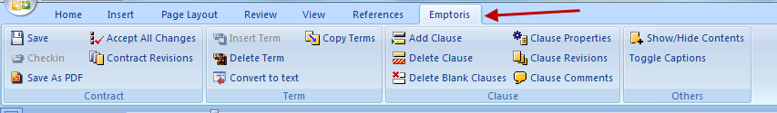
Emptoris Toolbar
The Emptoris toolbar (ribbon) contains features and functions to help you manage the language and terms of the contract.
Functions are context sensitive and some may be ‘grayed out’ until you are in a specific clause or term value.
NOTE: It is suggested that you NOT have Word open at the time you open a contract in the Word Editor. If Word is already open, the Emptoris ribbon may not appear. If so, exit Word and open the contract in the Word Editor again.

Slide 11
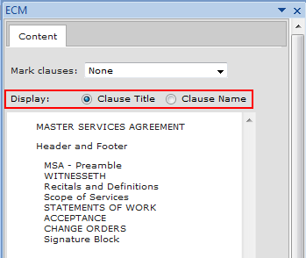

Content Pane
At the far right of the Emptoris editor is the Content pane, which contains a list of the clauses in the contract.
The Content pane can also be used to navigate directly to a clause:
  Notice first that you can have either Clause Titles or Names displayed.
  Click on a Clause Title/Name to display that clause in the document window.
  (If contract is very short (e.g., for testing) and the clause is already displayed, this will appear to do nothing.)
To hide or collapse the Content pane, click on “Show/Hide Contents” on the upper right side of the toolbar. To restore, click the button again.

Slide 12
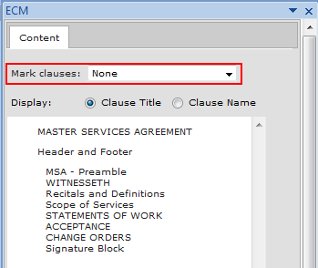
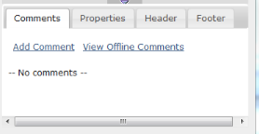
Contents Window, cont.
In the Content pane, selecting an option in the “Mark clauses” dropdown causes the qualifying clauses to be flagged according to the legend at the bottom of the pane.
  e.g., choosing “Need my Approval” flags the clauses for which your approval is needed.
  e.g., choosing “Modified from Standard” flags clauses that have been changed from the clause template.
Note: Changes to Term values are NOT considered to be modifications to a clause, and likewise do not trigger clause approval requests.
Below the Content Pane is the Clause Info Pane, which consists of the Comments Tab, the Properties Tab, the Header Tab and the Footer Tab. They display the related information for the currently selected clause.

Slide 13
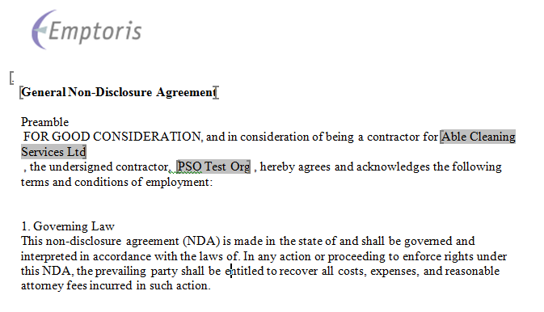
Document Window
The document window displays the language and terms of the contract.
  The contract appears to be one document, but is actually a representation constructed by ECM out of the various clauses. A real contract document is only created if you Download or Check Out.
Language Terms are displayed as blue/green (cyan) or gray highlighted areas.
  Blue/green highlights indicate terms that are mandatory.
  Gray highlighted terms are optional or system terms that are entered from some other part of the system.

Slide 14
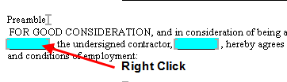

Edit Language Terms
The Language Terms can be edited in the Terms tab or directly in the Language of the contract.
Right click on the term.
  The Term menu is displayed.
In this example, we select Edit Term.
  The Edit Term dialog box is displayed.

Slide 15
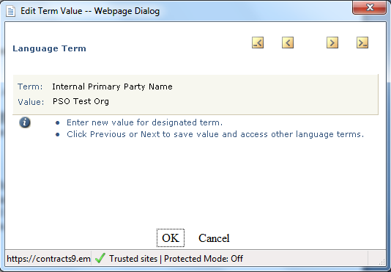
Edit Language Terms, cont.
The Edit Term dialog box displays the Term name and an input field for the value.
  The value may be selected from a drop down menu or entered directly into the field. For this example, we selected the value from a drop down menu.
Click the Locate Next Language Term (right single chevron icon) or the Locate Previous Language Term (left single chevron icon) to move forward (or back) to another Term in the contract.
  The system will “step through” all of the terms in a document in the order they appear in the language.
  Alternately, you can click the Locate Next Blank Language Term (right chevron and dash icon) or the Locate Previous Blank Language Term (dash and left chevron icon) to move to a term with no entered value.
Continue entering values until all terms
have been displayed.
Click OK to return to the
Document window.
Notes:
The Clause Library functionality is not available in TEST. It will be available in Production.

Slide 16
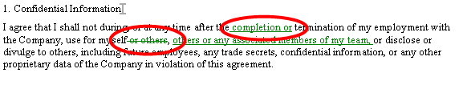

Edit Language Text
To edit Language Text:
Click to position the cursor within the language of the document.
Type new text or delete text using standard editing keys and functions.
  The new text will be highlighted in a new color.
  Deletions may be shown using a “strike-through”.
  The new text and strike-through color is determined by your personal MS Word preferences.
Click Save. The Accept All Changes icon is activated.

Slide 17

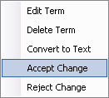
Accept or Reject Changes
For individual Terms and specific language changes (additions or deletions), you can accept or reject the change.
  Right click the term or language
  Select from the edit menu
    Accepting a change causes it to be kept and its highlighting removed.
    Rejecting a change causes it to be undone.
For all language and terms, click Accept All Changes to accept the modifications.
Click Save to save the changes to ECM.

Slide 18
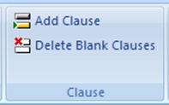
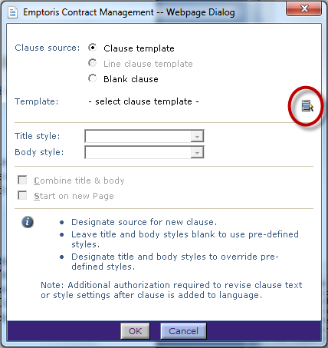
Add a Clause
You can add clauses to the contract from the clause library, if needed.
In the document, click in the “space” where
the new clause is to be added. It will be added
there (or after the selected clause, if you are on the Language tab).
Click the Add Clause icon
  The Add Clause dialog box is displayed.
In Clause Source, click the desired radio
button. For this example, we selected
Clause Template.
Click the Select Clause Template icon.
Notes:
The Clause Library functionality is not available in TEST. It will be available in Production.

Slide 19
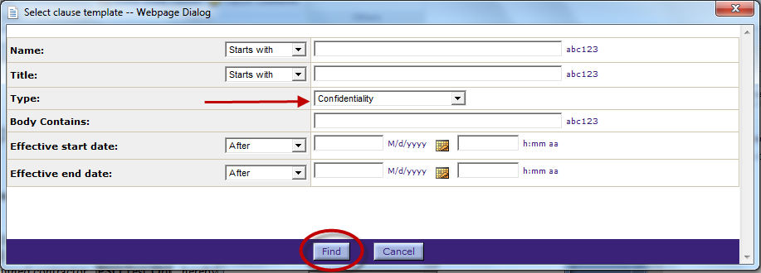
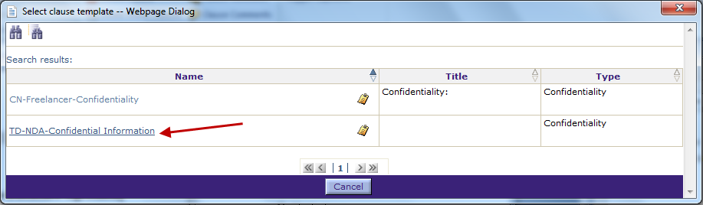
Add a Clause, continued
Enter search criteria.
For example, select the “Type” drop down to narrow your search for the right clause.
Click Find. The list of clauses matching your criteria is displayed.
Click the clause name hyperlink to select the clause.

Slide 20
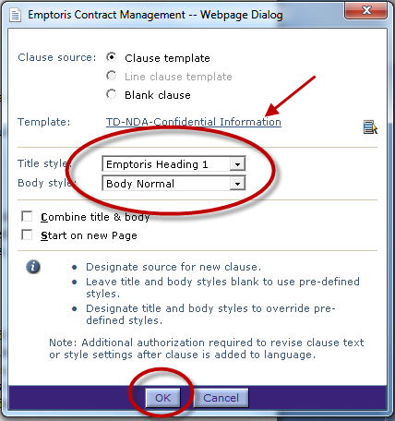
Add a Clause, continued
The selected clause template is added to the Add Clause dialog box.
Select the Title and Body styles from the drop down menus.
Select the formatting options check
boxes as desired.
Click OK to insert the clause.

Slide 21
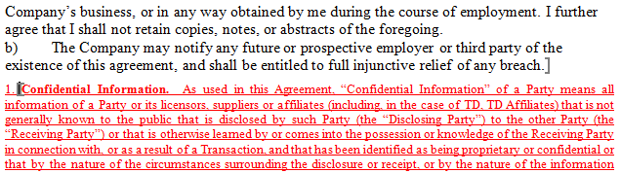
Add a Clause, continued
The new clause is added to the language.
Edit the terms and language, as needed.

Slide 22
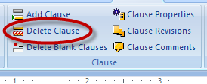
Delete a Clause
To delete a clause, place the cursor in that clause, or click the clause name/title in the Content pane (as shown earlier).
Click the Delete Clause icon.
  As of V10, you receive a warning prompt for confirmation before deletion occurs.
  Clause deletions are not tracked as “tracked changes” in the system.
Click Save.

Slide 23
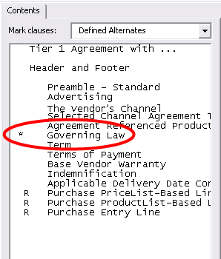
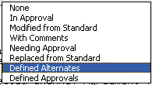
Select an Alternate Clause
Select Defined Alternates from the Mark Clauses dropdown menu.
Clauses with alternate clauses available are marked with an * asterisk.
Click in the clause name to position the cursor in the clause.
Click the Alternate Clause icon on the blue toolbar.
The Select Alternate Clause dialog box is displayed.
Notes:
The Clause Library functionality is not available in TEST. It will be available in Production.

Slide 24
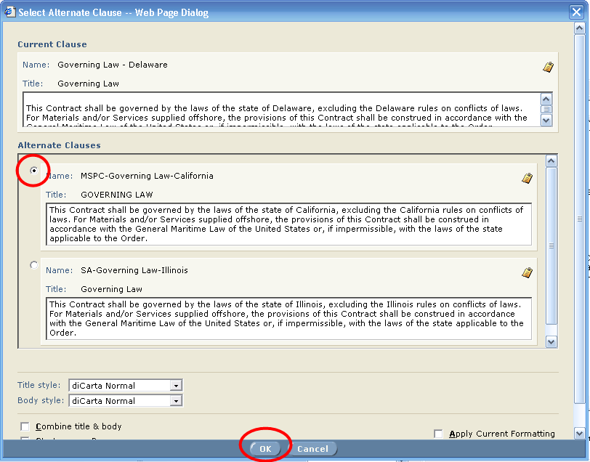
Select an Alternate Clause, cont.
A list of alternate clauses is displayed. Review each clause and click the radio button for the appropriate clause.
Click OK to select the clause.

Slide 25
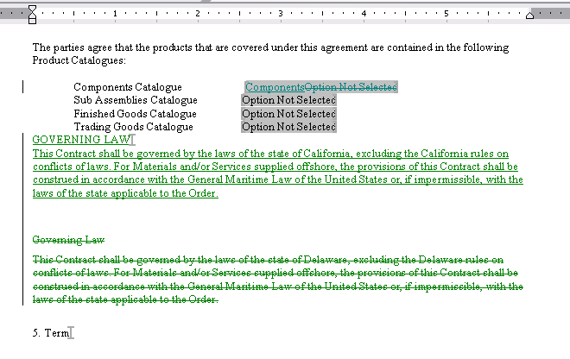
Select an Alternate Clause, cont.
The new clause is added to the Contract and the original clause is marked for deletion.
Edit the Text and Terms as appropriate
Click Save to save the changes.

Slide 26
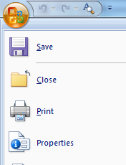
Exit the Edit Mode
To exit, click the Exit Word option at the bottom of the MS Word menu.
Note: If you have other MS Word documents open, click Close to close only this document.

Slide 27

Questions?

